Slide 1
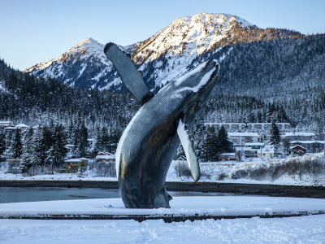
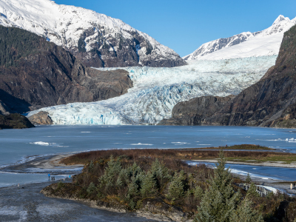
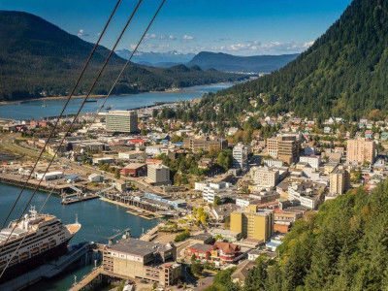
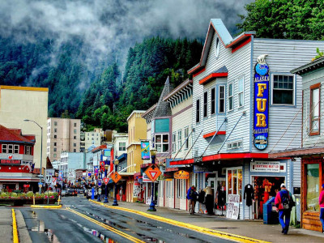

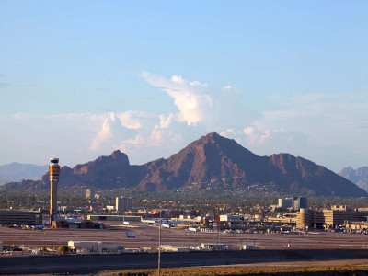
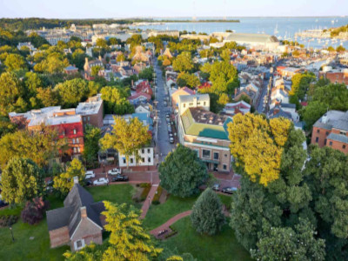


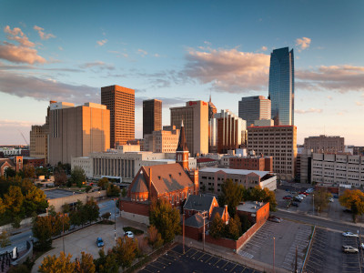
Alaska
58°F
22%
In June, Juneau experiences mild and relatively cool temperatures due to its location in a temperate rainforest. Average high temperatures range from 58°F (14°C) to 64°F (18°C), while average low temperatures range from 45°F (7°C) to 50°F (10°C). Juneau also receives a fair amount of rainfall, so it's advisable to pack appropriate rain gear when visiting.
Discover the rich cultural and natural history of Alaska at the Alaska State Museum. It showcases exhibits on indigenous art, history, wildlife, and more. Enjoy kayaking or canoeing in the serene waters of Juneau's fjords and bays. You can paddle amidst breathtaking scenery and observe wildlife such as seals, sea lions, and eagles.
Arizona
Maryland
Pennsylvania
California
Oklahoma

Slide 2
58°F
Alaska
22%
Alaska
58°F
22%
Discover the rich cultural and natural history of Alaska at the Alaska State Museum. It showcases exhibits on indigenous art, history, wildlife, and more. Enjoy kayaking or canoeing in the serene waters of Juneau's fjords and bays. You can paddle amidst breathtaking scenery and observe wildlife such as seals, sea lions, and eagles. In June, Juneau experiences mild and relatively cool temperatures due to its location in a temperate rainforest. Average high temperatures range from 58°F to 64°F, while average low temperatures range from 45°F to 50°F Juneau also receives a fair amount of rainfall, so it's advisable to pack appropriate rain gear when visiting.
Discover the rich cultural and natural history of Alaska at the Alaska State Museum. It showcases exhibits on indigenous art, history, wildlife, and more. Enjoy kayaking or canoeing in the serene waters of Juneau's fjords and bays. You can paddle amidst breathtaking scenery and observe wildlife such as seals, sea lions, and eagles.
AZ
MD
PA
CA
OK
Select State

